Slide 1
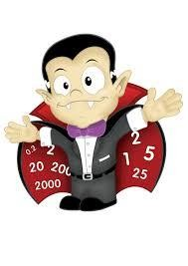
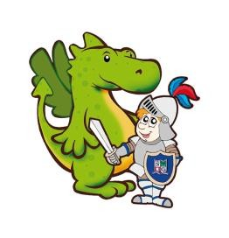


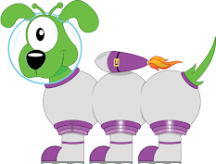
St George’s Y4 Multiplication Tables Check (MTC)
Parent Workshop
Faith, Respect, Service, Kindness, Perseverance

Slide 2
Aims
◆ National expectations and wider importance.
◆ Year 4 times tables check.
◆ Cognitive Load Theory.
◆ The teaching approach at school.
◆ Supporting pupils at home.
◆ Useful resources.
◆ Questions.

Slide 3
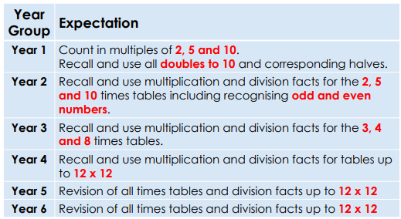
National Expectations

Slide 4
The Multiplication Tables Check (MTC)
◆ The Multiplication Tables Check (MTC) has been administered to children in Year 4, from Monday 1st June 2025 to the 15th June 2026. It is a statutory assessment for most pupils.
◆ The purpose of the MTC is to determine whether Year 4 pupils can recall their multiplication tables up to 12 x 12 fluently as outlined in the National Curriculum.
◆ Children will be tested using a computer, where they will have to answer multiplication questions against a clock. The test will last no longer than 5 minutes; children will have 6 seconds to answer each question in a series of 25.
◆ The results will be reported to the Department of Education. Parents will be informed about results in end of school report.
◆ https://www.timestables.co.uk/multiplication-tables-check/ Practice
website.

Slide 5
Why are times tables important?
◆ Times tables knowledge underpins much of the primary Maths curriculum.
◆ Mastering times tables and having the ability to quickly recall known facts is a necessary step to approaching more challenging topics as they progress through school.
◆ In school, we use the findings of John Sweller’s Cognitive Load Theory to inform our teaching practice.

Slide 6
Cognitive Load and Times tables
◆ Cognitive Load Theory states that learners have a limited capacity in their
working memory and we must not over load this.
◆ This means that if pupils are having to work hard to recall or calculate times tables facts, they will have less capacity available to absorb new and more complex information.
◆ Secure times tables knowledge ensures more capacity and a higher level of success when approaching new concepts in mathematics.

Slide 7
Which topics in primary school maths require times tables knowledge?

Slide 8
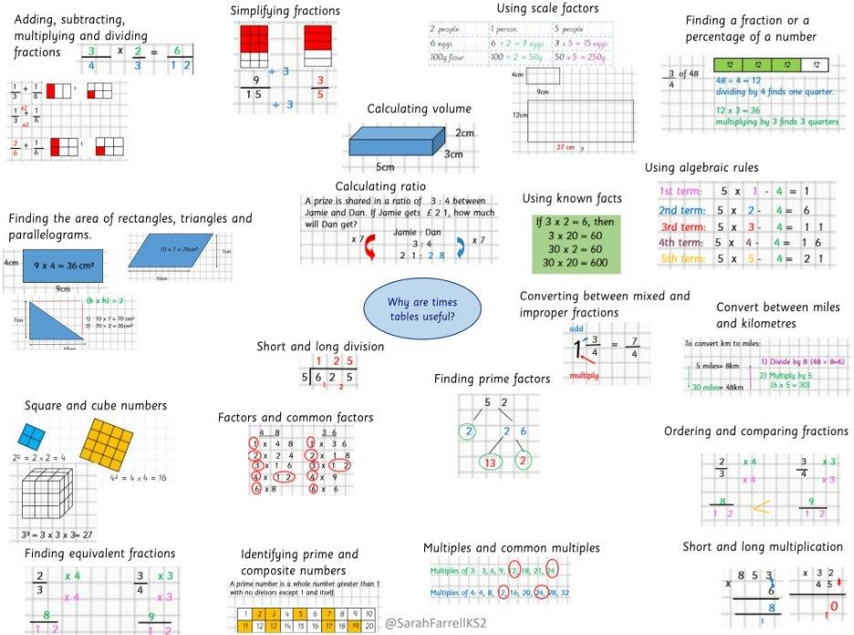
KS2 topics which require times tables knowledge.
◆ Fractions.
◆ Decimals.
◆ Multiplication.
◆ Division.
◆ Area.
◆ Ratio.
◆ Square and cube numbers.
◆ Place value.
◆ Prime numbers.
◆ Common multiples.
◆ Factors.

Slide 9
How we teach times tables at St George’s.
◆ We have placed times tables knowledge at the centre of the Maths curriculum.
◆ Times tables are taught every day for at least five minutes in our CLIC session – little and often.
◆ We use a range of activities – songs, pattern spotting, counting in multiples, games, online resources.
◆ Weekly times tables homework and weekly assessments ‘learn its Beat that’ tests.
◆ The data from these assessments is used to inform intervention groups. Extra sessions with Ms Adams.
◆ In addition, we aim to develop pupils number sense. This means the ability to spot patterns, use related facts to retrieve other information and be flexible with the knowledge they.

Slide 10
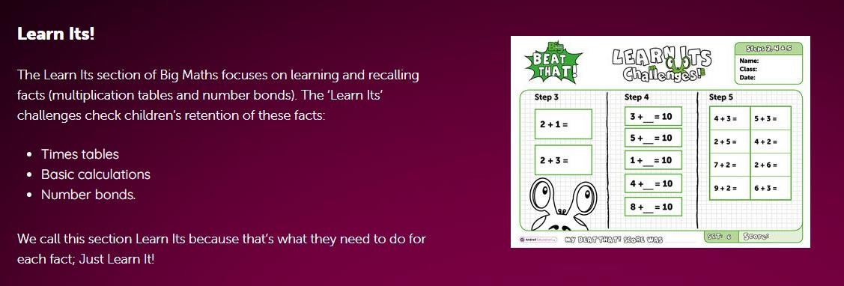

Slide 11
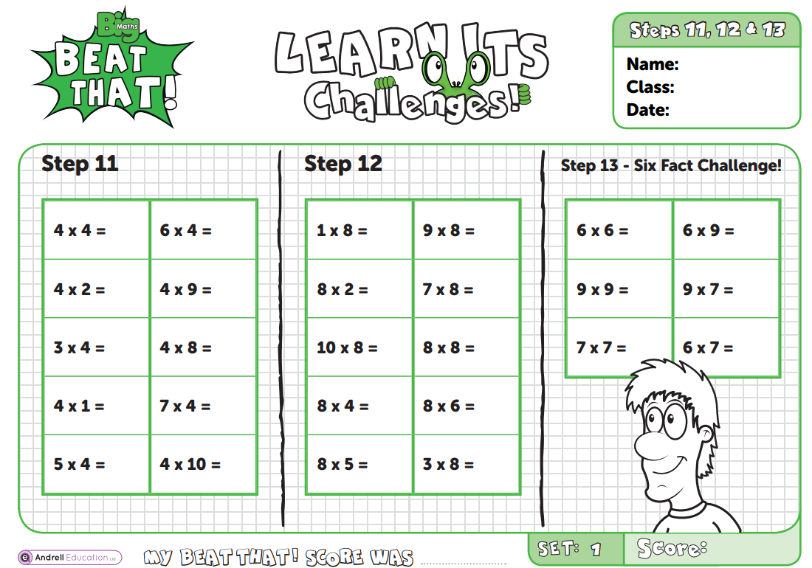

Slide 12


How can you help?
◆ Parental guide (Demonstration after the presentation).
◆ Visit the school website – Children - Maths
◆ https://www.stgeorgesderby.srscmat.co.uk/curriculum/phonics-reading-and- maths-schemes/
◆ Daily practise – little and often.
◆ Make use of the apps and programmes school provides (TTrockstars).
◆ Make it fun! – play games, sing songs, flashcards.
◆ All the strategies shown are used to build up fluency and get pupils to a point where they can recall all the times tables facts (12 x 12).

Slide 13
How can you help?
◆ Ensure pupils practise being flexible with their facts.
◆ Skip count backwards and forwards.
◆ Start from different points in the times tables.
◆ Mix in related division facts.
◆ You could use flash cards.
◆ Vary the activities they use to practise. This will help keep it fresh and will help ensure they develop number sentence.
◆ Ask your child about Maths lessons, about what they are studying and about their weekly times tables assessment.

Slide 14
Tricky facts
◆ Pupils will often struggle on a few facts.
◆ You can use TTrockstars to help spot the facts they are regularly getting wrong.
◆ Display these facts around the house (fridge, bedroom, living room).
◆ Revise that fact as regularly as possible over the period of a few weeks.
◆ Intensive focus on one fact will help it stick in their memories. E.g. ask on the way to and from school, before dinner, after brushing teeth, waiting to cross the road etc.
◆ When they get more confident revisit it less regularly but don’t forget about it.
◆ You can also help them create a rhyme or saying to help them remember it. I ate and I ate until I was sick on the floor ( 8 x 8 is 64)
◆ 5678 Consecutive numbers - 56 = 7 x 8

Slide 15
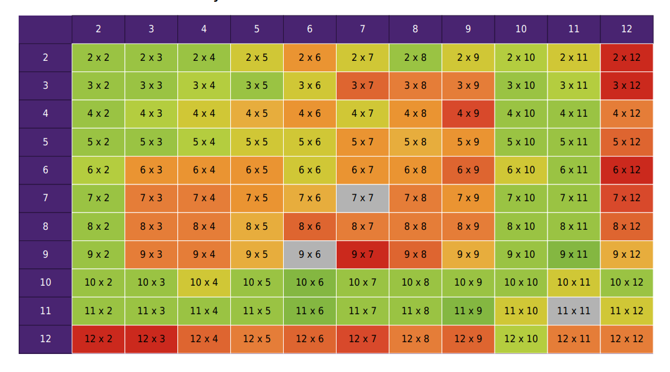
Heat Maps for each individual pupil will be shared at Parents Evening.

Slide 16
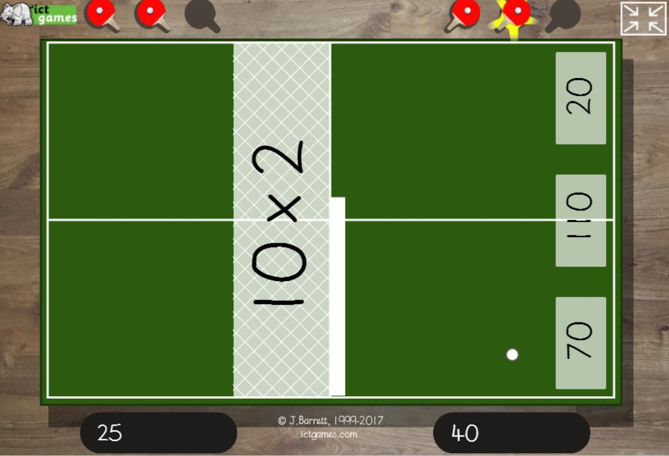
https://ictgames.com/tablesTennis/mo bile/

Slide 17
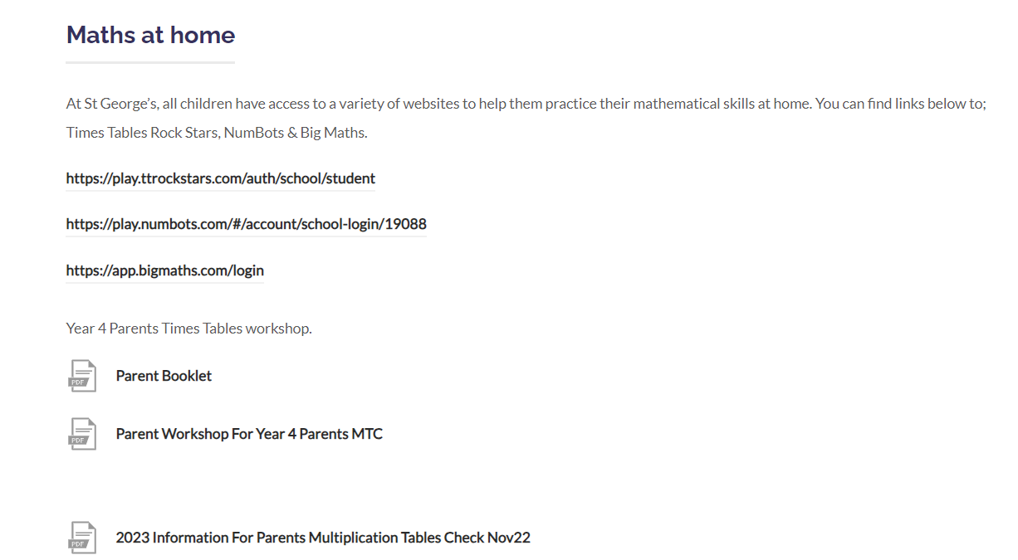
Website- https://www.stgeorgesderby.srscmat.co.uk/curriculum/maths-schemes/

Slide 18
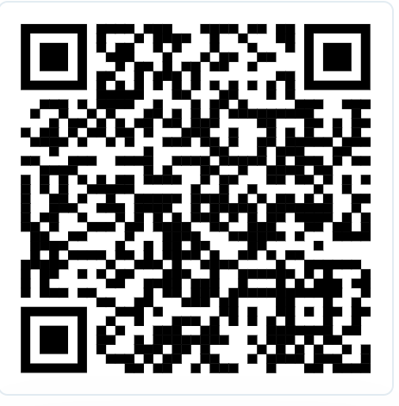
Questions?
Thank you
Feedback welcome – please complete the short survey.

