Slide 1
Let’s get ready to meet a member of the House of Lords!

Slide 2
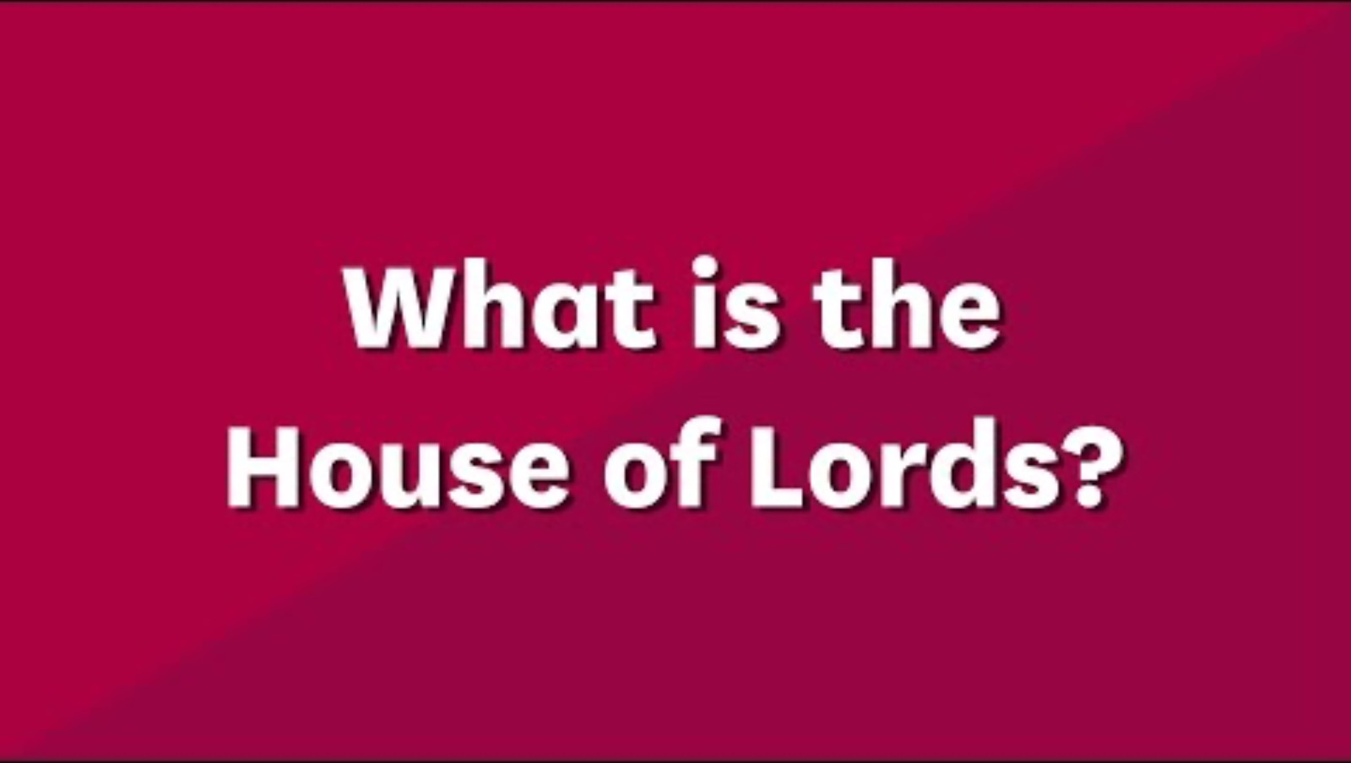
Watch this video...

Slide 3
How much do you remember?
3 minutes
1. What are the two Houses of Parliament called?
2. How many members of the House of Lords are there?
3. Members are chosen for their specialist experience in different jobs, can you remember three of these jobs

Slide 4
You’re about to see a picture of the House of Lords at work...
5 minutes
What do you notice?
What are your eyes drawn to?
What do you find interesting?
Write down
three questions for
your Baroness or Lord.
Share your ideas!

Slide 5
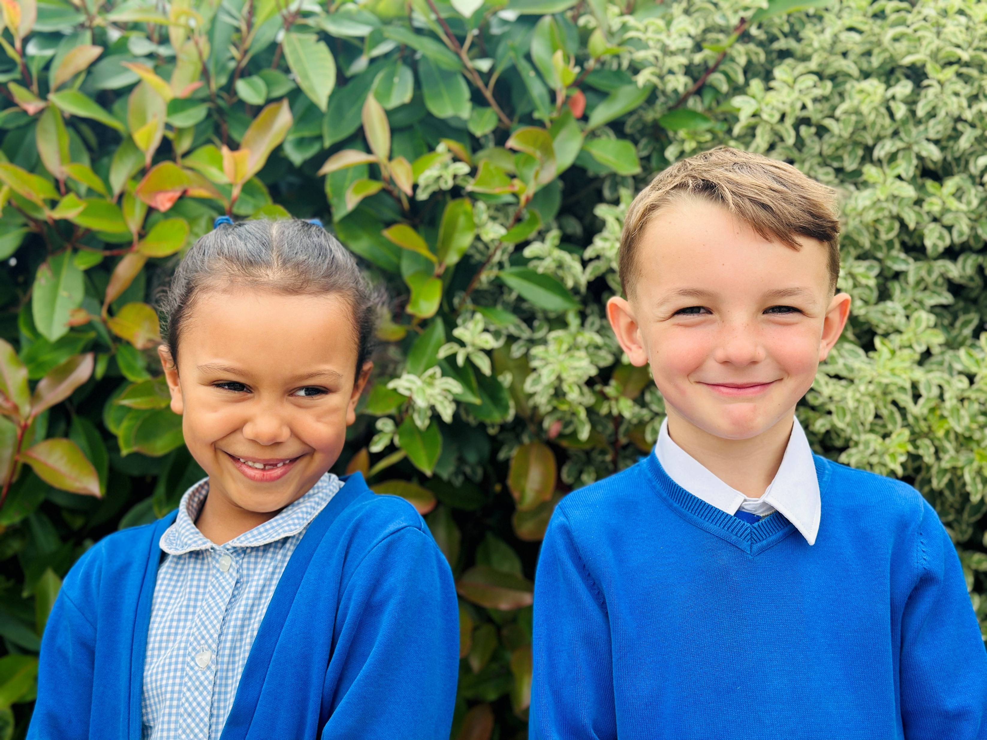
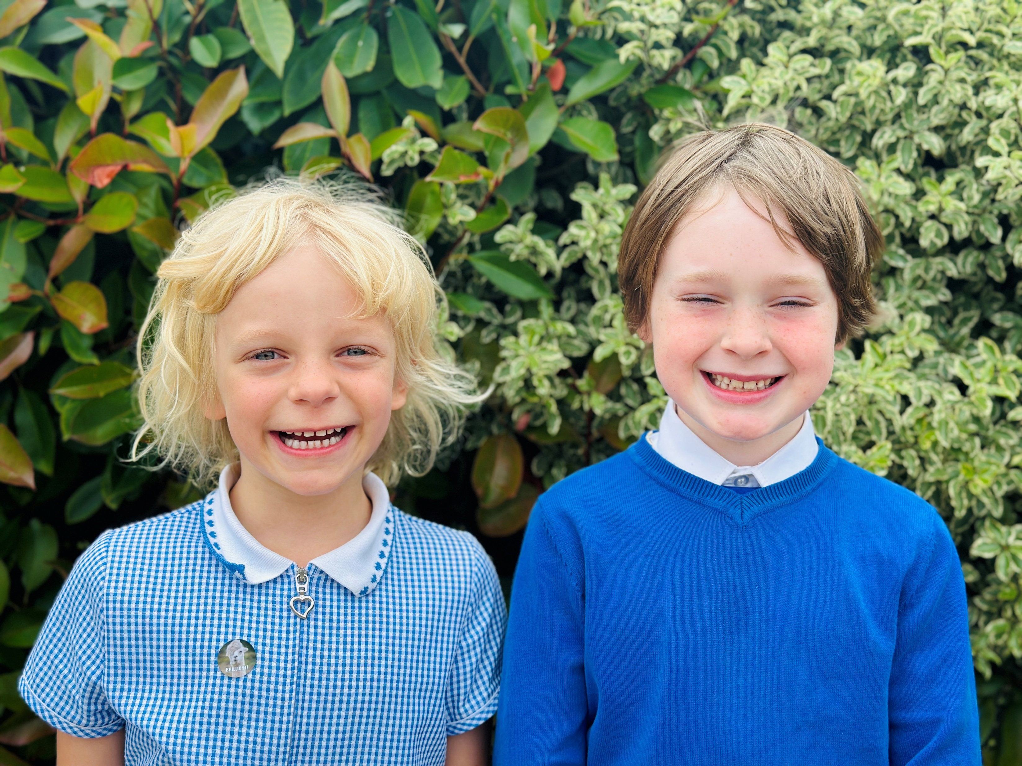
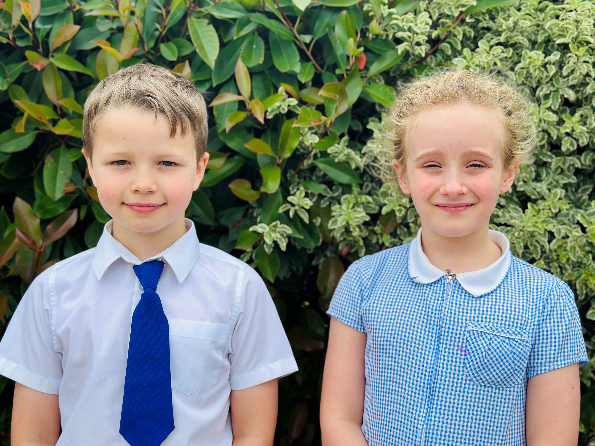
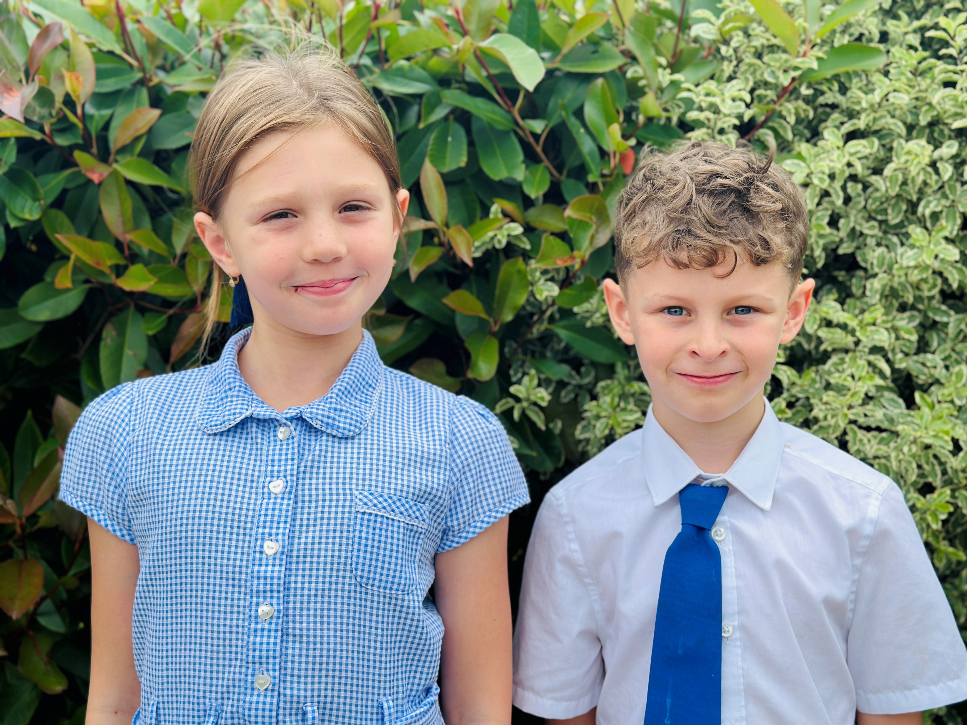
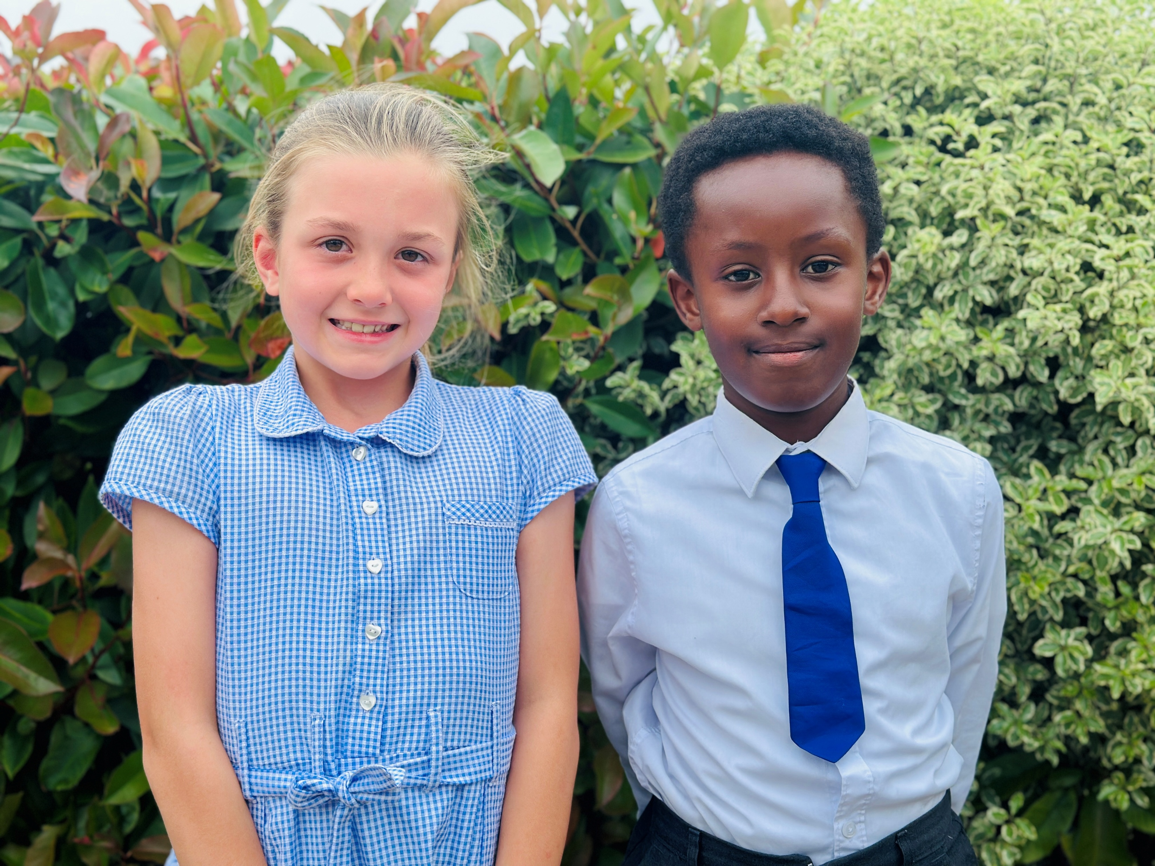
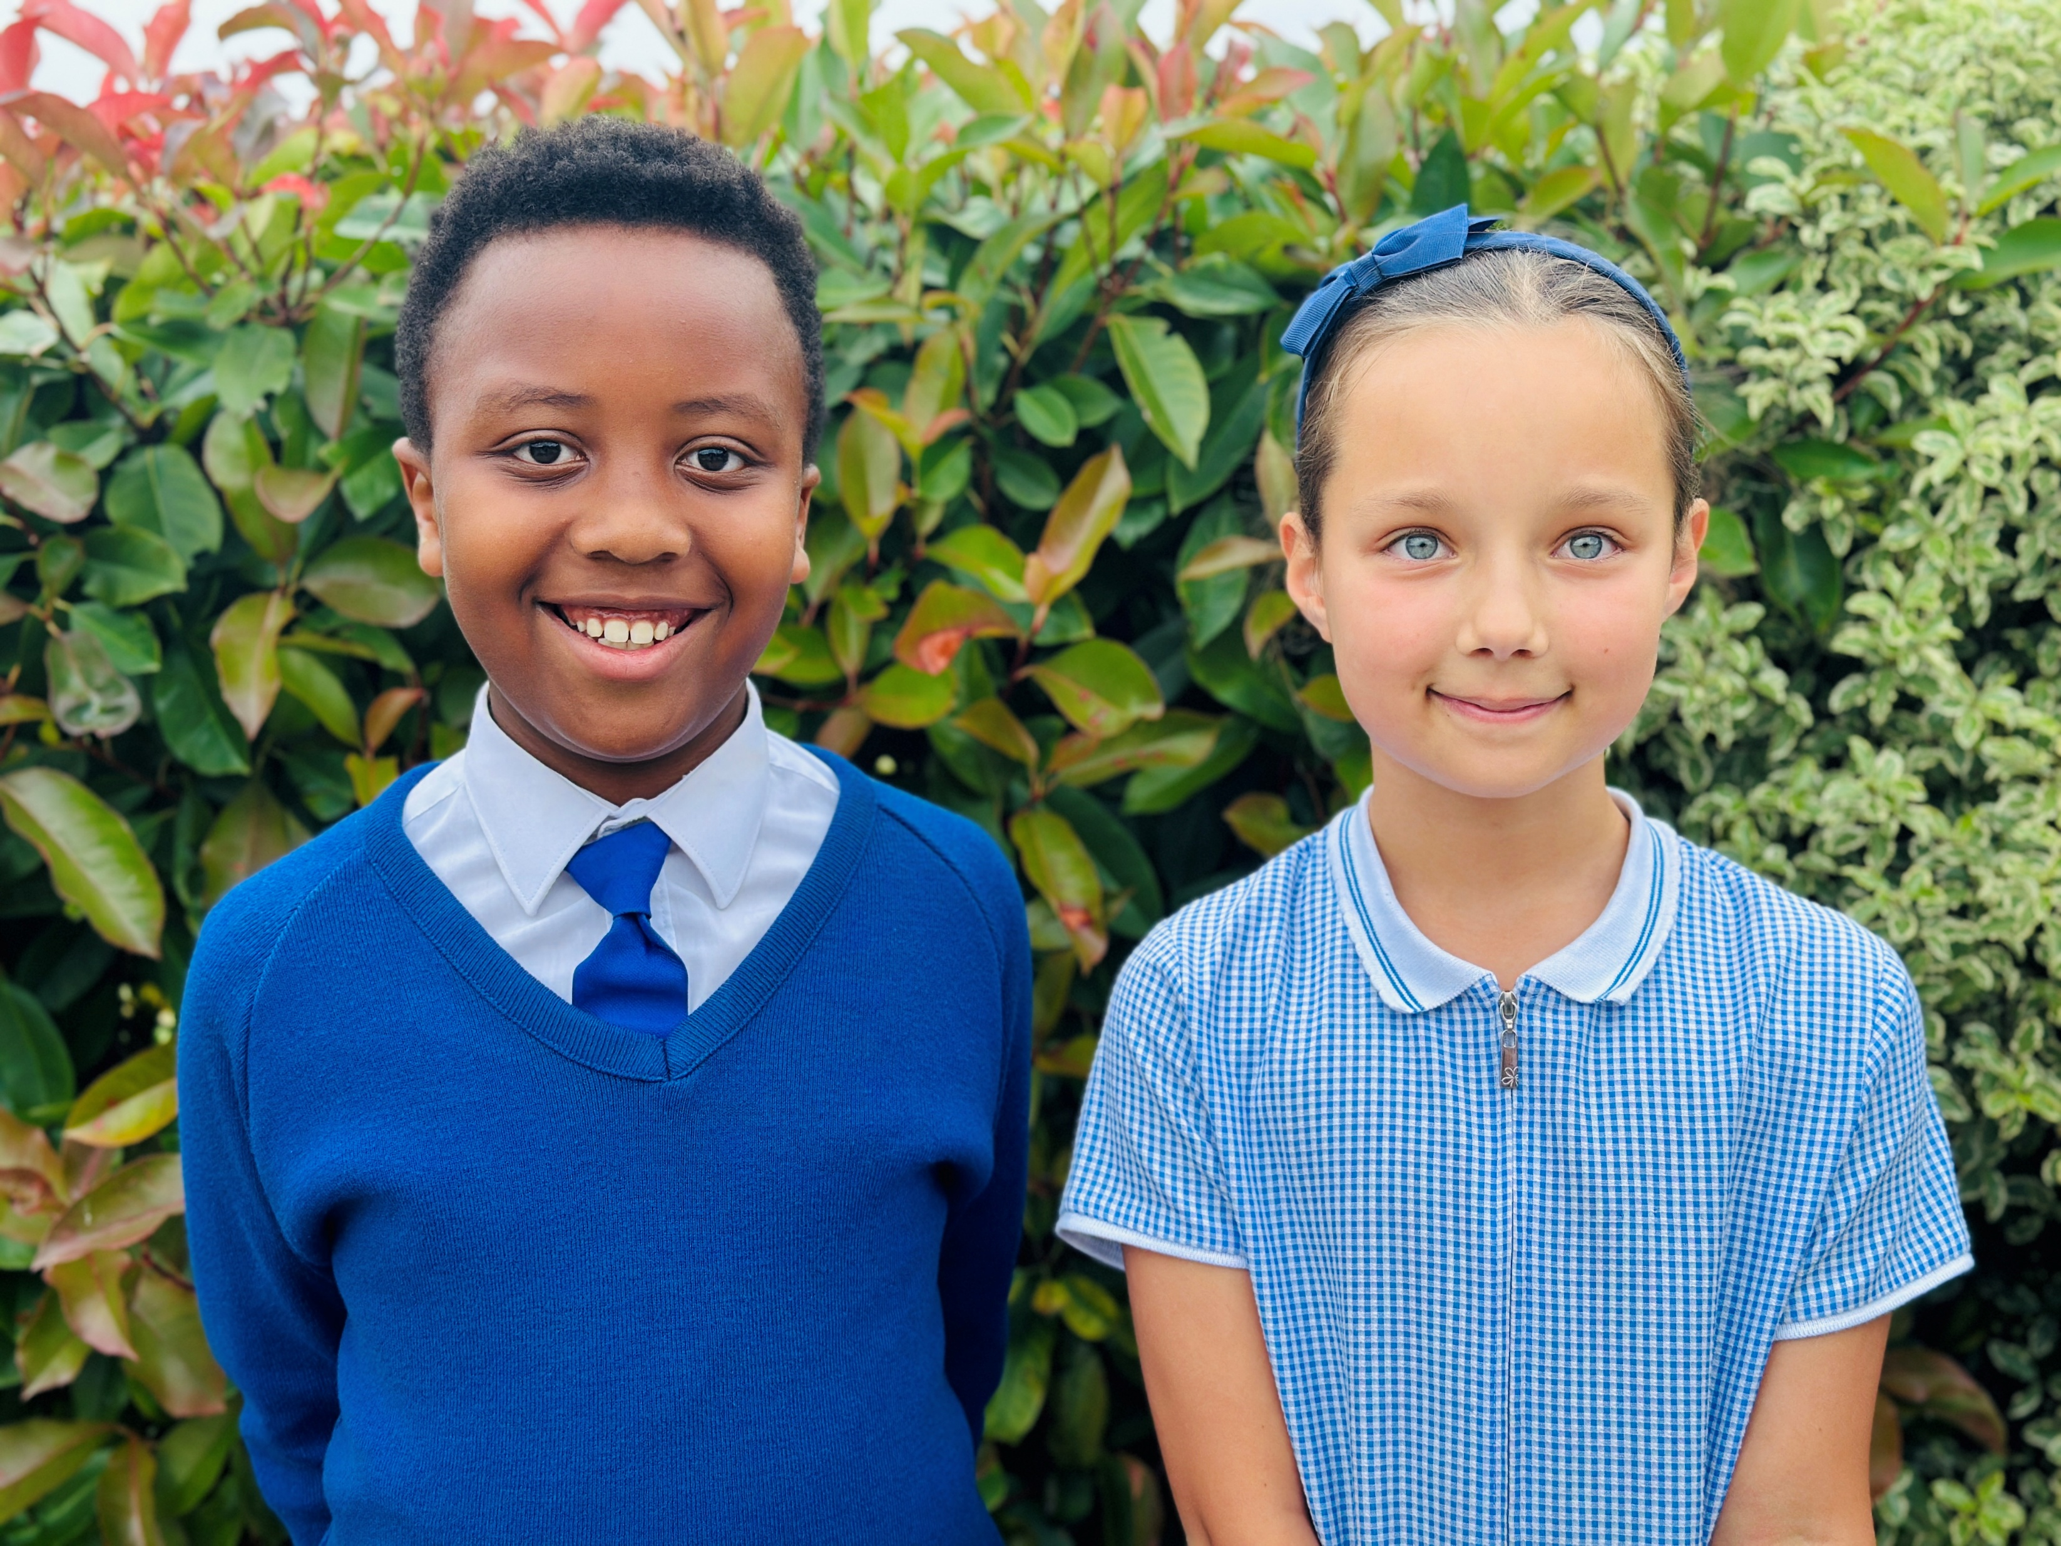
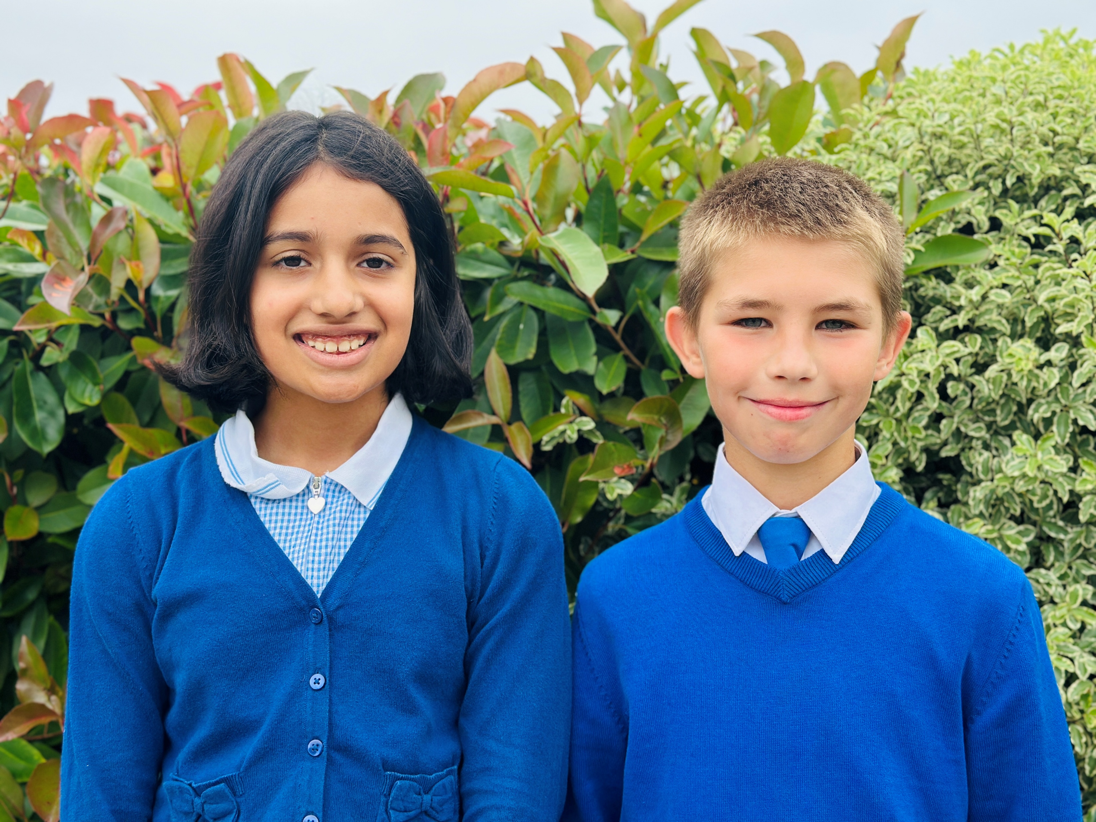

Slide 6
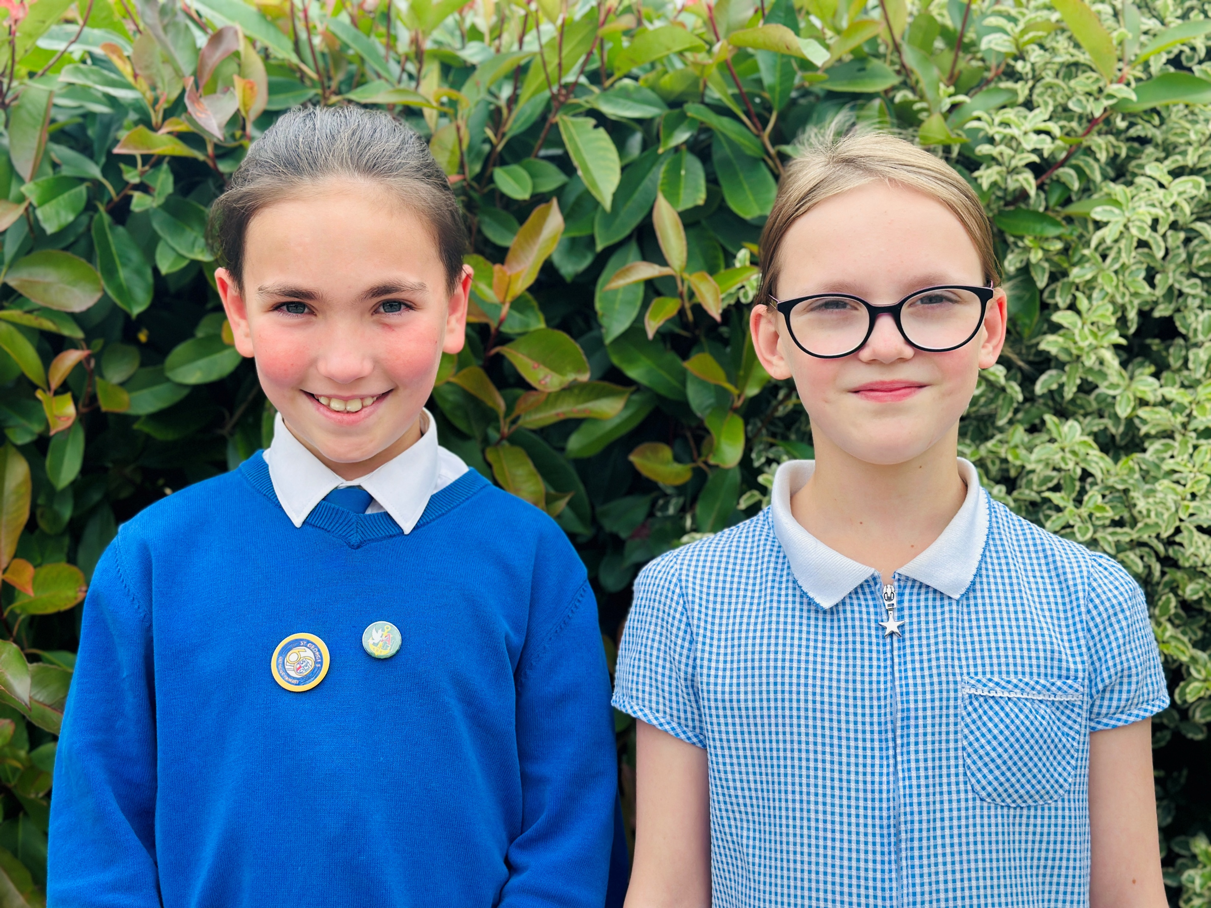
Trust Parliament Members (Ambassadors of Hope) – Daniel and Felicity

