Slide 1
Class 3
Teacher – Mrs Holmes
Teaching Assistant – Mrs Stringer
Class 4 Teacher – Mrs Sanders-Day
Teaching Assistant – Miss Goodwin
Key Stage 1 Lead – Mr Annable/Mrs Brunning

Slide 2
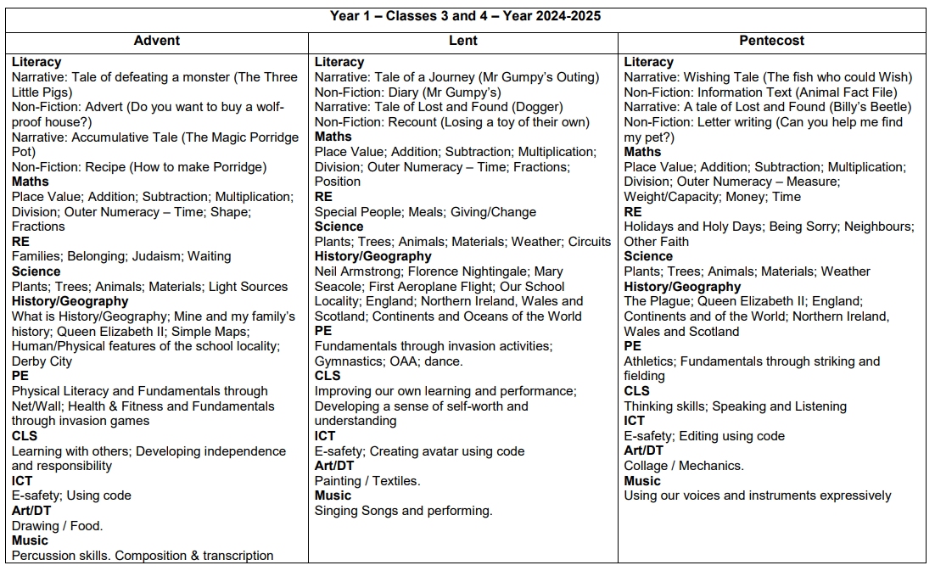

Slide 3
Reading Books and Homework
Homework
This will be given out on Monday and should be returned by Friday.
Children will generally have 2 pieces of homework.
Reading
Please also read with your child every day and sign their reading diary to say they have read.
Reading books will be changed as per their Read, Write, Inc lesson – this can range from every three days to once a week.
It is the child’s responsibility to empty their bag each morning and hand in.

Slide 4
Read Write Inc
Children will work in small groups for these sessions. They may not be working with their class teacher.
You may hear about ‘Fred
talk’. This is simply where
the children break down (segment) the words in
order to read and write them.

Slide 5
Handwriting
All children in the school have specialised handwriting books.
Please support your child at home: when writing, ensure that they hold a pencil correctly and form their letters correctly.

Slide 6
Numbots
We have a new ‘at home’ Maths resource called ‘Numbots’, which will help the children to learn their number facts - a big focus in school this year.
We have sent home log on details.
There is an expectation that children are engaging with this a few times a week for 5-10 minutes at a time.

Slide 7
Timetables
The children will be taught by different teachers and in different classrooms for non-core subjects.
(PE, Art & DT, Music and Computing)
Class 3’s PE days are Tuesday and Friday.
Class 4’s PE days are Monday and Wednesday.
Please make sure they have a complete PE kit in school at all times.

Slide 8
Dates for diaries
Celebration of the Word
Year 1 – Thursday 12th December 2024
Trip to Twycross Zoo – Monday 14th July 2025
Phonics screening check week – 9th June 2025
What does this involve…?

Slide 9
The children will be asked to “read” 40 words using their phonic skills. Half of these words will be “Alien” or nonsense words – there will be a small alien character next to the word so the children know that it is an “alien” word.

Slide 10
Uniform
Please ensure children are not wearing jewellery and earrings are only studs.
Playsuits are not allowed within the school uniform policy.
Please make sure they wear sensible and comfortable shoes.
Please label all your child’s clothes.

Slide 11
Anything else?
Please check school website (class pages) for regular updates, as well as important documents and links.
Please sign agreement in the front of your child’s reading diary.
If your child is unwell, please contact the school office for further guidance.
Please ensure your child has a water bottle at school and that it is named.

Slide 12
Any questions?
Alternatively, for more privacy, please email us using the class email address…
Class 3 – class3@geo.srscmat.co.uk
Class 4 – class4@geo.srscmat.co.uk

