Slide 1
Early Reading and Phonics

Slide 2
Read Write Inc
All children in EYFS and KS1 will take part in daily RWI lessons. 30-60 minutes.
Developing fluency and comprehension.
90% of our Y1 children passed the PSC in 2024. National was 80%

Slide 3
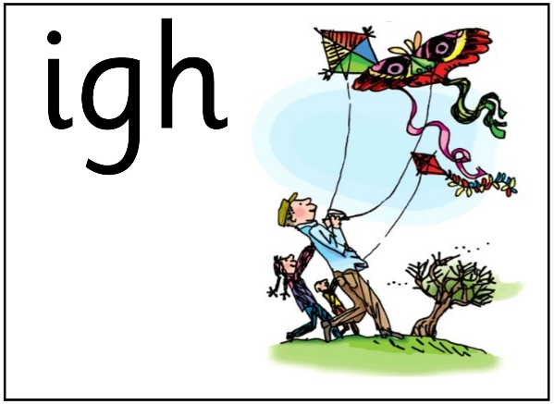
How Does It Work?
Children are assessed every 6 weeks and placed into groups based on their outcome.
Children are taught sounds matched to their group level.
They learn to read words using the strategy, “special friends, Fred talk, read the word.”
Aim to know all sounds by the end of Year 1 ready for the Phonics Screening Check. 75 in total
Children are assessed every 6 weeks and placed into coloured groups.
Children are taught sounds matched to their group level.
They learn to read words using the strategy, “special friends, Fred talk, read the word.”
Aim to know all sounds by the end of Year 1 ready for the Phonics Screening Check.

Slide 4
RWI Progression
Group A
Group B
Group C
Ditty
Red
Green
Purple
Pink
Orange
Yellow
Blue
Grey
comprehension

Slide 5
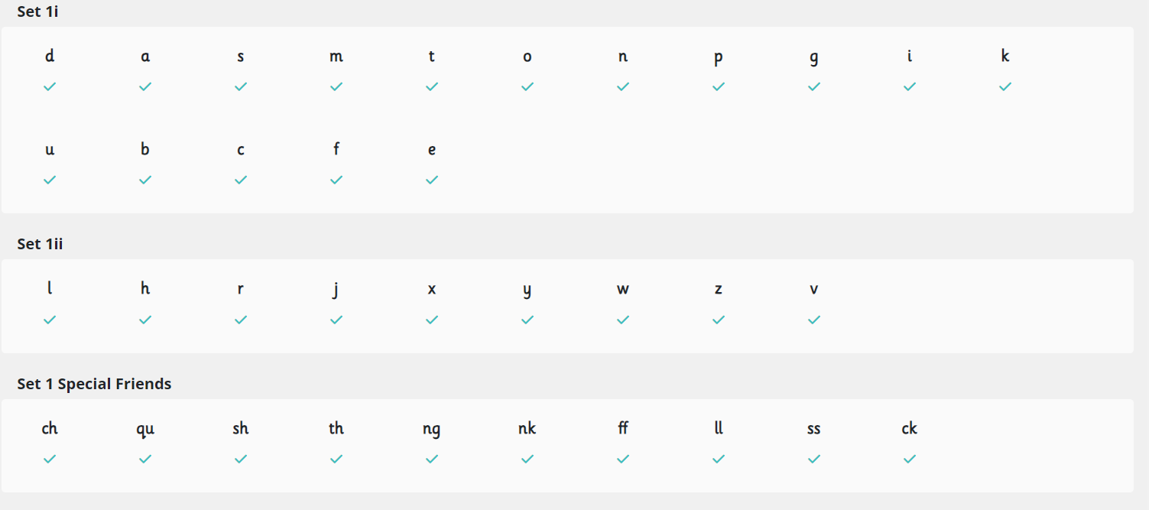
GROUP a, b, c, Ditty and red

Slide 6
Green, purple and pink

Slide 7
Pink, orange, yellow, blue and grey

Slide 8
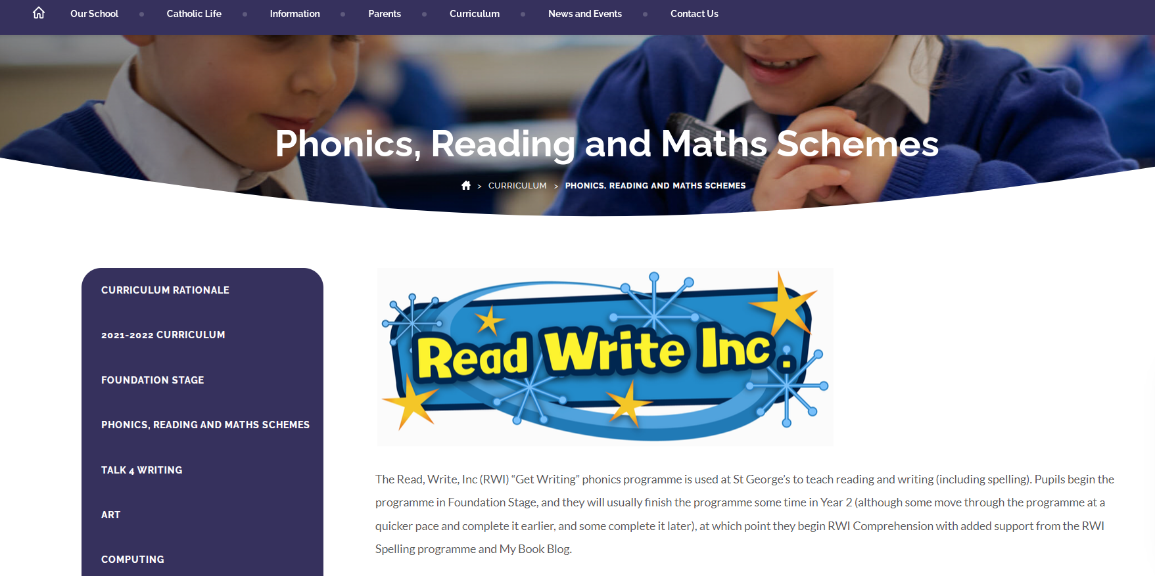
Supporting Reading At Home
Reading books are closely matched to your child’s ability – children read last week’s book.
Parent workshops to follow later this year.
More information on our school website – lots of resources to support you and your child.

