Slide 1
CST – Catholic Social Teaching

Slide 2
Aims…
To understand the term ‘ Catholic Social Teaching’ and it’s importance within our school.
To look at what we’ve done as part of CST last year.
To look at our plans as a school moving forward.

Slide 3
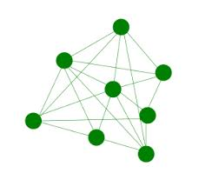
What makes our Catholic RE scheme different to others?
It’s at the centre of everything that we do.
It’s authentic.
From EYFS to Year 6 we contextualise learning – Links, Bridges, Connections
Allows children to flourish; to learn their story.
- Their faith journey
- Their heroes and heroines of the Bible
- To find God within everything
We marinade our children in the beliefs and values of the school ethos.
We aim to shape children to challenge, change and reform through the eyes of God.

Slide 4
Catholic Social Teaching in a nutshell…
Is based on the belief that God has a plan for creation. A plan to build his kingdom of peace, love and justice.
That God has a special plan for every single one of us, whoever we are.
Our part in this plan isn’t just limited to things ‘spiritual’ or times when we do ‘religious things’. It involves every aspect of our lives, from the things we pray about to how we live as responsible global citizens.
Our part of this story is a kind of vocation for the common good,
a call to treat everyone as our brothers and sisters.
It is something that we can all share.

Slide 5
Catholic Social Teaching in a nutshell…

Slide 6
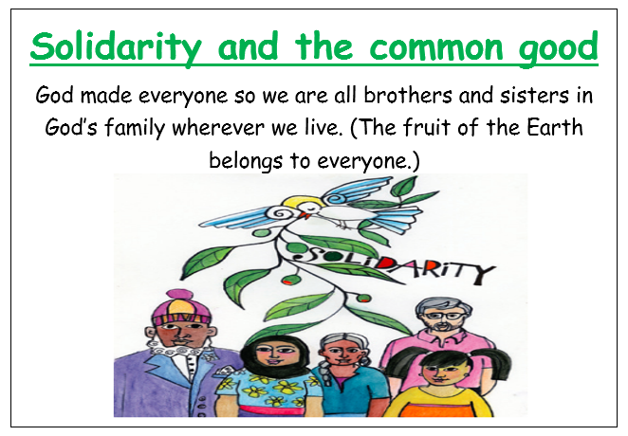
Catholic Social Teaching in a nutshell…

Slide 7
Catholic Social Teaching in a nutshell…

Slide 8
Catholic Social Teaching in a nutshell…
Think of it as our moral compass, guiding us on how to live out our faith in the world.

Slide 9
What have we worked on so far…
Harvest Collection – Food collection from pupils for the Padley and Hope Centre
2 other faiths weeks during the year – Judaism and Sikhism
Advent Retreat Day – Led by One Life Music
CAFOD World Gifts -
CAFOD Live Simply Award – 12 months award looking at 3 aspects: Live simply, sustainable and in solidarity
Mardi Gras – Learning the history behind the festival around the world. (Shrove Tuesday)
Colour Run – fundraising for CAFOD
Lent – Passion play
Lent workshops at Newmount Church
Easter craft morning in EYFS
Celebration of the Queen’s Jubilee – Focus on her leadership over the past 70 years
Pentecost Retreat Day – Symbols of Pentecost
Whole school liturgy
Healthy Fortnight
Diversity week – Looking at the differences between staff and pupils in school (religion, culture, SEN needs)
STEM fortnight – Work on sustainability within our school environment led by local author Kath Wheatley
Planned learning opportunities of CST in RE and geography.
Caritas taught on a 3 weekly cycle.

Slide 10
What plans have we got coming up…
This term:
Continuation of Live Simply Award – Focus on food waste, energy waste, paper waste in school
Introduction of phase charities
Harvest appeal – Food collection from pupils for the Padley and Hope Centre
Other faiths week – Judaism: The Open Centre will be working with children from each class
Pilgrimage of all children in school to St George’s Church (KS2 during the Advent term.)
Carol singing at the local old peoples home
Clothes bank – Linked with St George’s Parish Church
Advent appeal – Collection of unwanted items (toys, toiletries etc) which can be distributed to local charities
Continuation of work on our school ECO garden
Vocations week
Planned learning opportunities in RE, geography, history, science
Caritas taught on a 3 weekly cycle
Next September
September – Birthday of Mary (Looking at female leaders)
The season of creation

