Slide 1
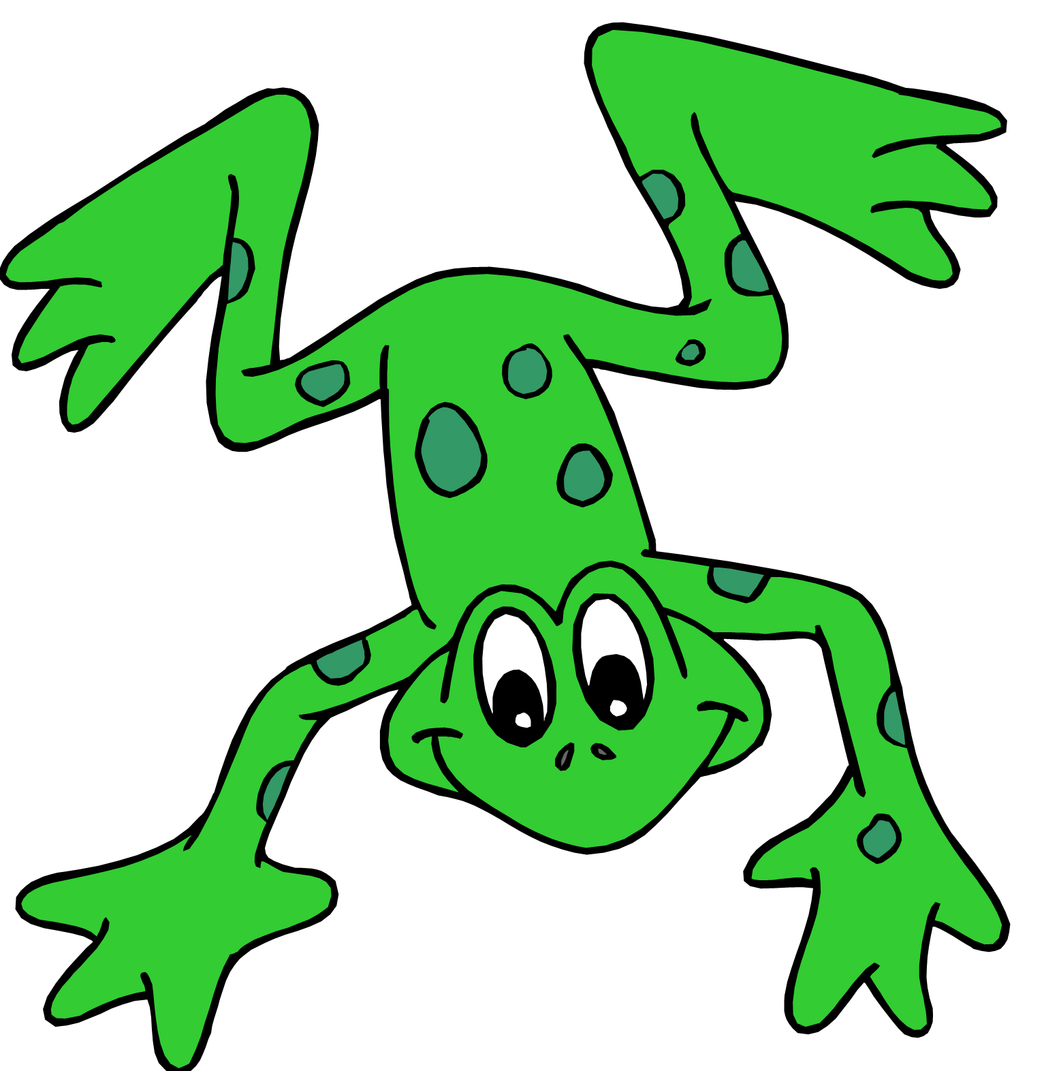
Fred Frog needs your help!

Slide 2
Help him to read these
NEW WORDS

Slide 3
Don’t forget: 1) Special Friends. 2) Fred Talk. 3) Blend

Slide 7
Don’t forget: 1) Special Friends. 2) Fred Talk. 3) Blend

Slide 11
Don’t forget: 1) Special Friends. 2) Fred Talk. 3) Blend

Slide 15
Don’t forget: 1) Special Friends. 2) Fred Talk. 3) Blend

Slide 19
Don’t forget: 1) Special Friends. 2) Fred Talk. 3) Blend

Slide 23
Don’t forget: 1) Special Friends. 2) Fred Talk. 3) Blend

Slide 27
Don’t forget: 1) Special Friends. 2) Fred Talk. 3) Blend

Slide 31
Don’t forget: 1) Special Friends. 2) Fred Talk. 3) Blend

Slide 35
Don’t forget: 1) Special Friends. 2) Fred Talk. 3) Blend

Slide 39
Don’t forget: 1) Special Friends. 2) Fred Talk. 3) Blend

Slide 43
Don’t forget: 1) Special Friends. 2) Fred Talk. 3) Blend

Slide 47
Don’t forget: 1) Special Friends. 2) Fred Talk. 3) Blend

Slide 51
Don’t forget: 1) Special Friends. 2) Fred Talk. 3) Blend

Slide 55
Don’t forget: 1) Special Friends. 2) Fred Talk. 3) Blend

Slide 59
Don’t forget: 1) Special Friends. 2) Fred Talk. 3) Blend

Slide 63
Don’t forget: 1) Special Friends. 2) Fred Talk. 3) Blend

Slide 67
Don’t forget: 1) Special Friends. 2) Fred Talk. 3) Blend

Slide 71
Don’t forget: 1) Special Friends. 2) Fred Talk. 3) Blend

Slide 75
Don’t forget: 1) Special Friends. 2) Fred Talk. 3) Blend

Slide 76
phlaim

Slide 78
quake

Slide 79
Don’t forget: 1) Special Friends. 2) Fred Talk. 3) Blend

Slide 80
splurn

Slide 81
praints

Slide 82
strike

